Slide 1
Session 3 – Map Reduce

Slide 2
Pre - requisites
Complete Unit 3.0
Faculty Video Lecture
Self Assessment Quiz Complete
Cloudera Virtual Machine Installed
Basic Linux Commands Practiced

Slide 3
Session Content (Map Reduce)
Queries on Unit 3.0
Map Reduce – Traditional Approach
Map Reduce – Hadoop Approach
Word Count Examples Explained
Hadoop Partitioners
Hadoop Combiners

Slide 4

Queries on Unit 3.0

Slide 5
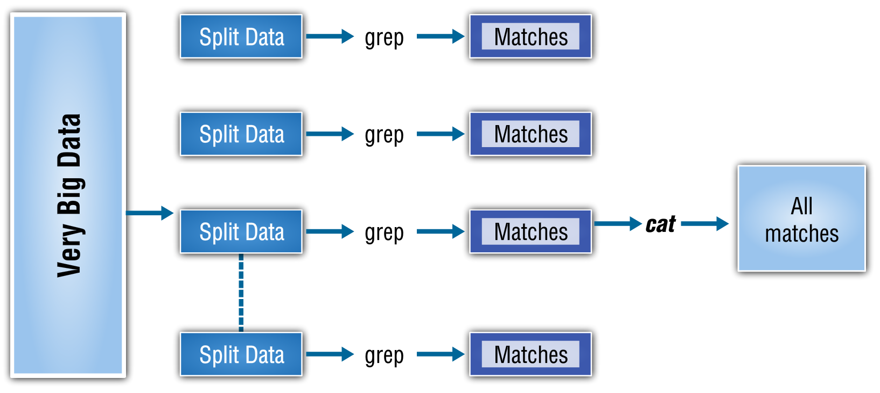
Map Reduce – Traditional Way

Slide 6
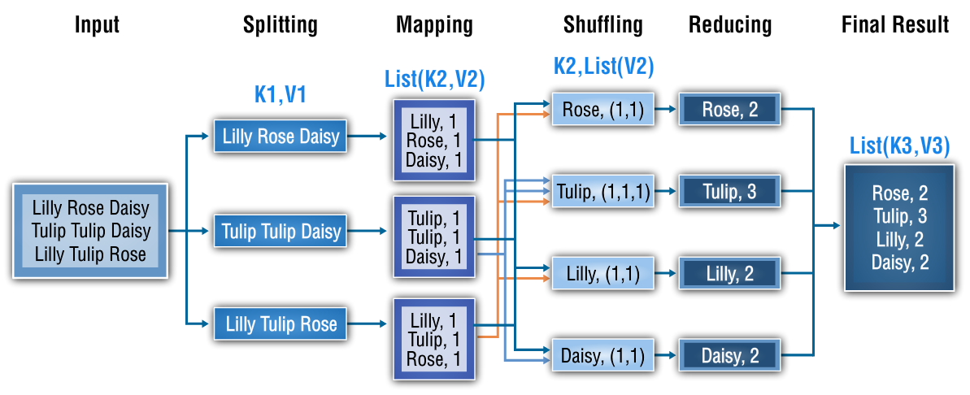
Map Reduce – Hadoop Approach

Slide 7
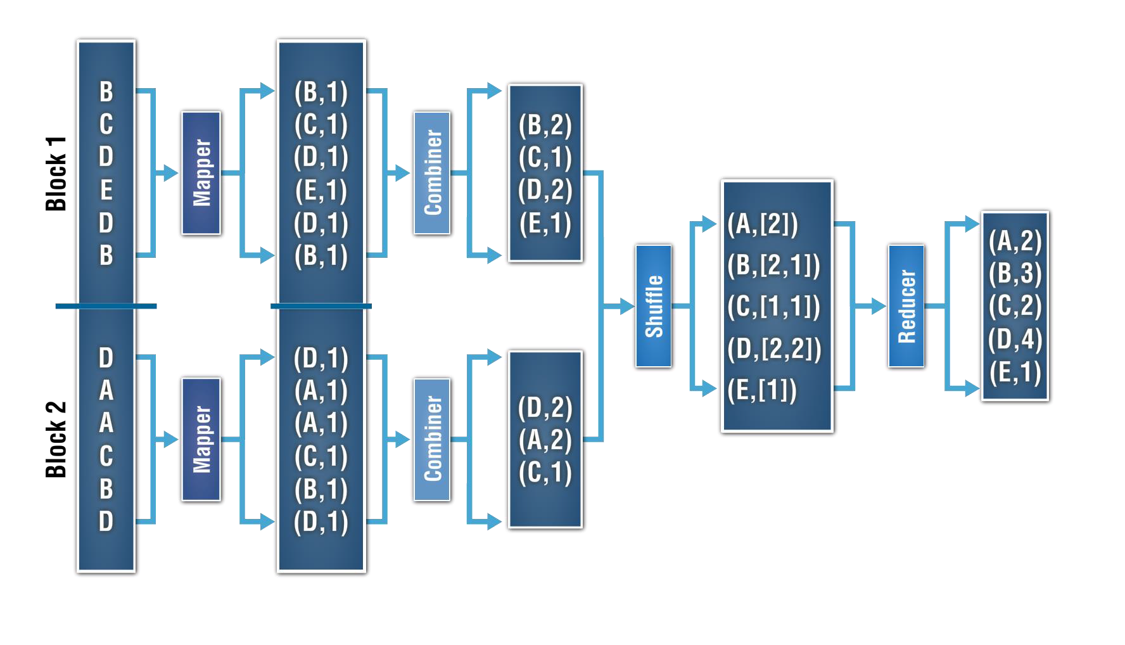
Map Reduce – Hadoop Approach

Slide 8
Map Reduce – Partitioners

Slide 9
Queries on Unit 3.0

